Slide 1
L2 (CHAPTER 5)
Programming in Assembly
Part 1: ARM ISA
Exercises ANS

Slide 2
Question: Endianness
Q: Assume Big Endian ordering. If a 32-bit word resides at memory address N, what is the address of:
  (a) The MSB (Most Significant Byte)
  (b) The 16-bit half-word corresponding to the most significant half of the word
Q: Redo the question assuming Little Endian ordering.
N+3
LSB
N+2
Big-Endian
N+1
N
MSB
N+3
MSB
N+2
Little-Endian
N+1
N
LSB

Slide 3
Answer: Endianness
Q: Assume Big Endian ordering. If a 32-bit word resides at memory address N, what is the address of:
  (a) The MSB (Most Significant Byte)
  (b) The 16-bit half-word corresponding to the most significant half of the word
Redo the question assuming Little Endian ordering.
A: With Big Endian ordering:
  (a) N
  (b) N (the half-word has address range of [N, N+1], so its address is N)
With Little Endian ordering:
  (a) N+3
  (b) N+2 (the half-word has address range of [N+2, N+3], so its address is N+2)
N+3
LSB
N+2
Big-Endian
N+1
N
MSB
N+3
MSB
N+2
Little-Endian
N+1
N
LSB

Slide 4
Question: Endianness
32-bit
Words
Bytes
Addr.
0015
Addr
=
??
0014
Word 3
0013
0012
What are the memory addresses of these four words?
0011
Addr
=
??
0010
Word 2
0009
0008
0007
Addr
=
??
0006
Word 1
0005
0004
0003
Addr
=
??
0002
Word 0
0001
0000

Slide 5
Answer: Endianness
32-bit
Words
Bytes
Addr.
0015
Addr
=
0x000C
0014
Word 3
0013
0012
What are the memory addresses of these four words?
Same as the address of the lowest-address Byte
(this is true for either Little-Endian or Big-Endian ordering)
0011
Addr
=
0x0008
0010
Word 2
0009
0008
0007
Addr
=
0x0004
0006
Word 1
0005
0004
0003
Addr
=
0x0000
0002
Word 0
0001
0000

Slide 6
Question: Endianness
The word stored at address 0x20008000
with Big-Endian ordering is
Memory Address | Memory Data
0x20008003 | 0xA7
0x20008002 | 0x90
0x20008001 | 0x8C
0x20008000 | 0xEE
?
The word stored at address 0x20008000
with Little-Endian ordering is
?
Notes:
Halfword access and signed halfword/byte accesses were added to the architecture in v4T, this is the reason the offset field is not as flexible as the normal word/byte load/store - not a problem because these accesses are less common.
Link: diagram on next slide

Slide 7
Answer: Endianness
The word stored at address 0x20008000
with Big-Endian ordering is
Memory Address | Memory Data
0x20008003 | 0xA7
0x20008002 | 0x90
0x20008001 | 0x8C
0x20008000 | 0xEE
0xEE8C90A7
The word stored at address 0x20008000
with Little-Endian ordering is
0xA7908CEE
Endianness only specifies byte order, not bit order in a byte!
Notes:
Halfword access and signed halfword/byte accesses were added to the architecture in v4T, this is the reason the offset field is not as flexible as the normal word/byte load/store - not a problem because these accesses are less common.
Link: diagram on next slide

Slide 8
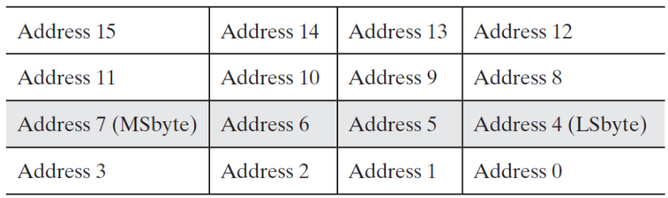
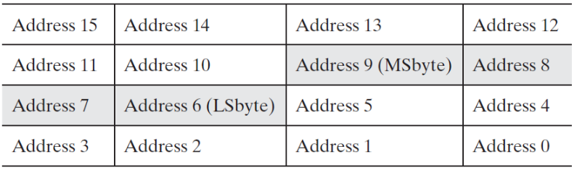
Data Alignment
Review
Assume a byte-addressable memory with a data bus that is 32 bits (4 bytes) wide
Consider 16 bytes of memory (addresses 0 to 15) arranged as four 32-bit words (4 bytes each)
Well-aligned: each word begins on a mod-4 address, which can be read in a single memory cycle
Ill-aligned: a word begins on address 6, not a mod-4 address, which can be read in 2 memory cycles
The first read cycle would retrieve 4 bytes from addresses 4 through 7; of these, the bytes from addresses 4 and 5
are discarded, and those from addresses 6 and 7 are moved to the far right;
The second read cycle retrieves 4 bytes from addresses 8 through 11; the bytes from addresses 10 and 11 are discarded, and those from addresses 8 and 9 are moved to the far left;
Finally, the two halves are combined to form the desired 32-bit operand:

Slide 9
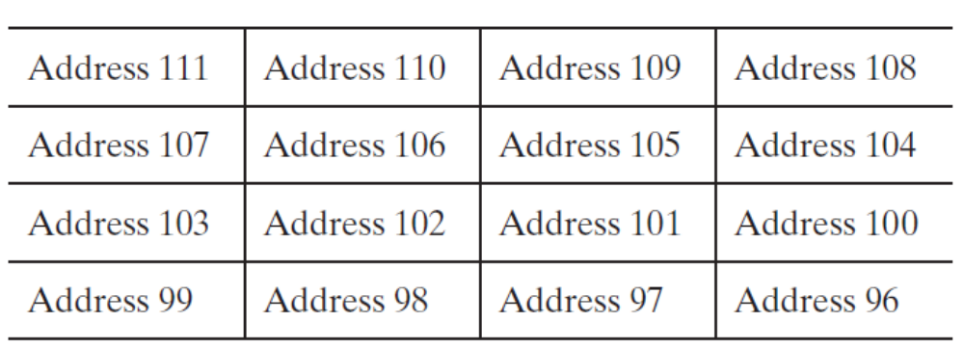
Question: Data Alignment
Q: Assume a byte-addressable memory with a data bus that is 32 bits (4 bytes) wide. Consider 16 bytes of memory (addresses 96 to 111) arranged as four 32-bit words (4 bytes each).
  (a) What is the address of the most significant byte of the word at address 102, assuming Little-Endian ordering?
  (b) What is the address of the most significant byte of the word at address 102, assuming Big-Endian ordering?
  (c) How many memory cycles are required to read the word at address 102?
  (d) How many memory cycles are required to read the half word at address 102?

Slide 10
Answer: Data Alignment
Q: Assume a byte-addressable memory with a data bus that is 32 bits (4 bytes) wide. Consider 16 bytes of memory (addresses 96 to 111) arranged as four 32-bit words (4 bytes each).
  (a) What is the address of the most significant byte of the word at address 102, assuming Little-Endian ordering?
  (b) What is the address of the most significant byte of the word at address 102, assuming Big-Endian ordering?
  (c) How many memory cycles are required to read the word at address 102?
  (d) How many memory cycles are required to read the half word at address 102?
A:
  (a) 105
  (b) 102
  (c) 2
  (d) 1

Slide 11
Question: Data Alignment
Q: Assume a byte-addressable memory with a data bus that is 32 bits (4 bytes) wide. How many memory cycles are required to read each of the following from memory?
  (a) A 2-Byte operand read from decimal address 5
  (b) A 2-Byte operand read from decimal address 15
  (c) A 4-Byte operand read from decimal address 10
  (d) A 4-Byte operand read from decimal address 20

Slide 12
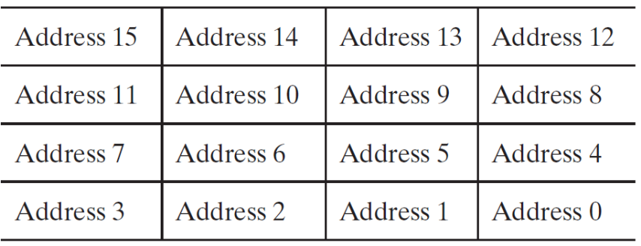
Answer: Data Alignment
Q: Assume a byte-addressable memory with a data bus that is 32 bits (4 bytes) wide. How many memory cycles are required to read each of the following from memory?
  (a) A 2-Byte operand read from decimal address 5
  (b) A 2-Byte operand read from decimal address 15
  (c) A 4-Byte operand read from decimal address 10
  (d) A 4-Byte operand read from decimal address 20
A: (a) The operand contains memory content in address range [5,6]. It can be read in 1 memory cycle; the memory controller returns a word in address range [4,7]. The operand can be obtained via 1-Byte offset addressing into the word.
(b) The operand contains memory content in address range [15,16]. It can be read in 2 memory cycles; the memory controller returns 2 words in address ranges [12,15] and [16, 19], which can be combined to return a word in address range [14,17]. The operand can be obtained via 1-Byte offset addressing into the word.
(c) The operand contains memory content in address range [10,13]. It can be read in 2 memory cycles; the memory controller returns 2 words in address ranges [8,11] and [12, 15], which can be combined to return a word with address range [10,13].
(d) The operand contains memory content in address range [20,23]. Since 20%4=0, it is well-aligned, and can be read in 1 memory cycle.

Slide 13
Question: Memory Cycles
Q: Assume a byte-addressable memory with a data bus that is 32 bits (4 bytes) wide.
  It takes ____ memory cycle(s) to read a Byte from memory
  It takes ____ memory cycle(s) to read a half-word from memory
  It takes ____ memory cycle(s) to read a word from memory
  It takes ____ memory cycle(s) to read a double word from memory

Slide 14
Answer: Memory Cycles
Q: Assume a byte-addressable memory with a data bus that is 32 bits (4 bytes) wide.
  It takes ____ memory cycle(s) to read a Byte from memory
  It takes ____ memory cycle(s) to read a half-word from memory
  It takes ____ memory cycle(s) to read a word from memory
  It takes ____ memory cycle(s) to read a double word from memory
A:
  It takes __1__ memory cycle(s) to read a Byte from memory
  It takes __1 or 2__ memory cycle(s) to read a half-word from memory
  It takes __1 or 2__ memory cycle(s) to read a word from memory
  It takes __2 or 3__ memory cycle(s) to read a double word from memory (a double word may span at most 3 consecutive words in memory)

Slide 15
Question: Arrays
Q: If the first element of a one-dimensional array x[] is located in memory at address 0x12345678, what will be the address of the second element if the array x[] contains
  (a) chars
  (b) shorts
  (c) ints
  (d) longs

Slide 16
Answer: Arrays
Q: If the first element x[0] of a one-dimensional array x[] is located in memory at address 0x12345678, what will be the address of the second element x[1] if the array x[] contains
  (a) chars
  (b) shorts
  (c) ints
  (d) longs
A: x[1]’s address is x’s address plus the data type size in Bytes
  (a) chars: 0x12345678+1= 0x12345679
  (b) shorts: 0x12345678+2= 0x1234567A
  (c) ints: 0x12345678+4= 0x1234567C
  (d) longs: 0x12345678+8= 0x12345680

